Slide 1
How I saved the World with Dailyclean, an open sourced tool developped in Quarkus
Guillaume THOMAS
Notes:
Hi eveyone ! Welcome to this talk.
My name is Guillaume and today, I would like to tell you a wonderful tail about GraalVM and Quarkus.

Slide 2
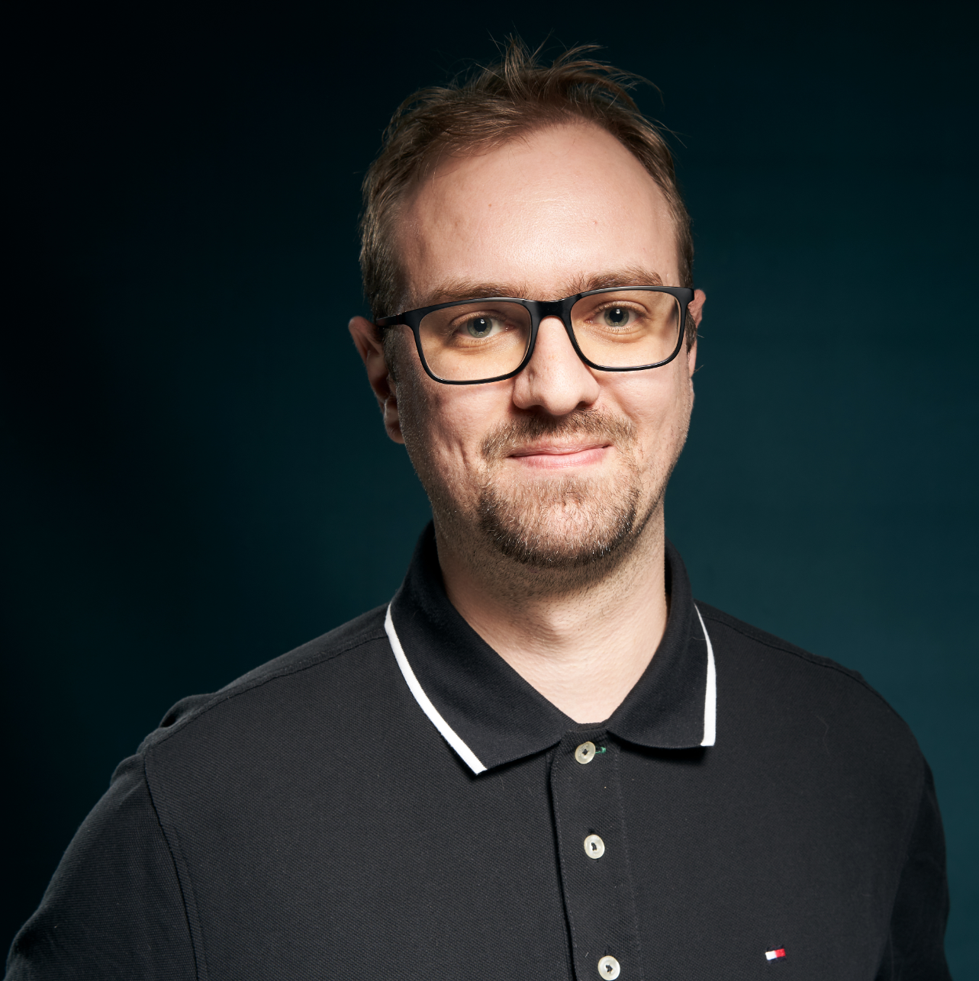
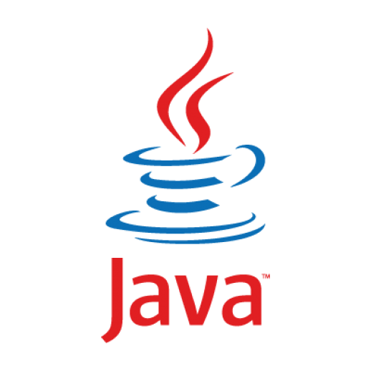
Guillaume THOMAS
ML Engineer
Guilde Data @AXAFR
Notes:
Our story begins in AXA France.
First, let me introduce myself. I'm currently working as an ML developer in a team called : BigData and new technology.
Our mission is to help Data scientists to make their AI applications working in production efficiently.
Often, these types of applications execute a lot of processes. So, we design our solutions as microservices.

Slide 3

What is the Dailyclean project
NOT the same Dailyclean than the Azure PaaS one
Dailyclean is an open-sourced tool by AXA France
Saves your resources by turning on and off your Kubernetes namespaces
Planified or on demand
It works with all the Kubernetes distributions
Good for your GreenIT and Finops objectives
Mandatory at AXA France
Based on Quarkus and GraalVM
Cop CaaS initiative

Slide 4
Demonstration
Notes:
This solution has been designed and developed by ops & developers. Let me take a minute to salute them : Thomas LEMARCHAND, Pierre-J=Henry Gache and Guillaume CHERVET
This tool allows developers, Ops and Product Owners to manage their namespaces.
Obviously, Production is NOT managed
- They can start or stop an application on the fly
- Thay can get the state of their application (stopped, starting, running)
- They can give a start hour and an end hour to automatically start and stop the application each day
They can get some other information
Unfortunately, this kind of tool does not exist out of the box with Openshift. So we had to create it.

Slide 5
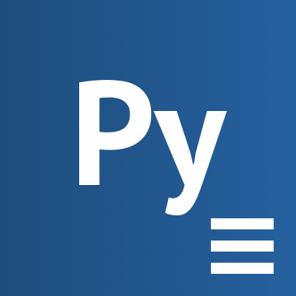
creates
executes
CronJob
Job
schedule = 0 9 * * *
Notes:
In openShift, a container is called a pod.
And in our case, Each pod is an instance of a microservice.
In OpenShift, pods are replicated.
To extinct a pod, you can set its replica number to 0
To start a pod, you can set its replica number to 1, at least.
To do so, our ops developed a script which can set this number of replicas for all the pods of a namespace.
To execute this script, Kubernetes gives us an object called a Job.
To plan an execution of a job each day, Kubernetes gives us an object called a CronJob.
In other words, A CronJob create and execute a Job. The Job execute a script.
We can set a TTL to this job. Then, when the job finishes its execution, it deletes itself.

Slide 6
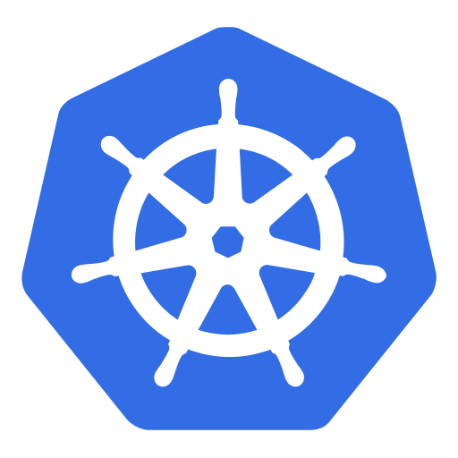


KUBERNETES API
CronJob start
Job start
Replicas = 1
DailycleanAPI
Replicas = 0
Job stop
CronJob stop
Job start
Replicas = 1
DailycleanFront
Job stop
Replicas = 0
Notes:
To summarize:
When we want to start pods from a namespace, we create a Job to start them.
When we want to stop pods from a namespace, we create a Job to stop them.
When we want to update start/stop scheduling, we delete and create a new CronJob.
To create or delete Jobs and CronJobs, we can use the Kubernetes API
Finally, we had to develop a front and an API which calls the Kubernetes API to manage our pods.

Slide 7
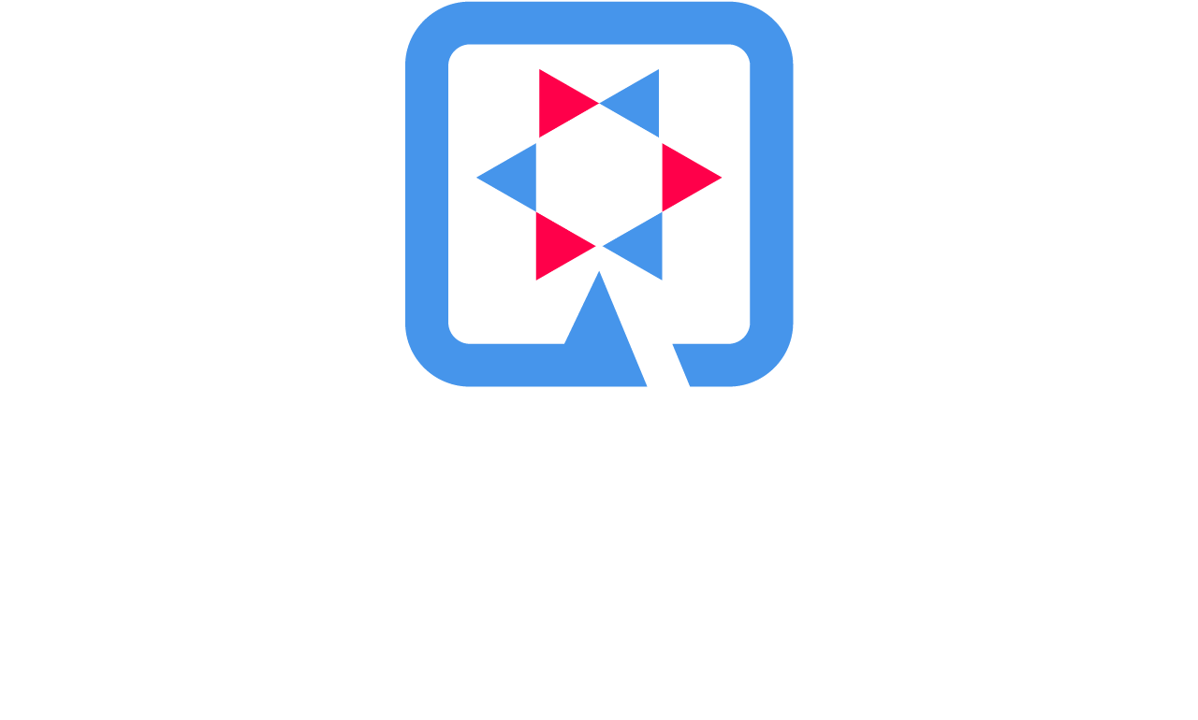
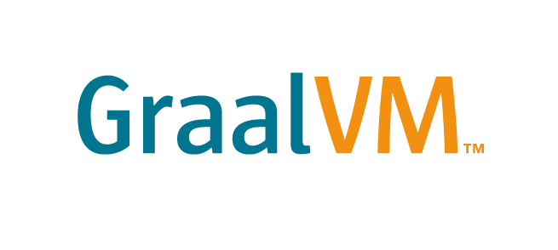
Notes:
And finally, Because there were Java developers in our team, we suggested to explore two new technologies to us.
And they are GraalVM & Quarkus.
Finally !
First what is graaalVM ?
Wikipedia definition ! Heeem !
GraalVM is a Java VM and JDK based on HotSpot/OpenJDK, implemented in Java. It supports additional programming languages and execution modes, like ahead-of-time compilation of Java applications for fast startup and low memory footprint.

Slide 8
Dailyclean is open sourced
https://github.com/AxaGuilDEv/dailyclean

Slide 9
Questions ?
guillaume.thomas@axa.fr
@gthomasIT

Slide 10
THANK YOU!!!

